Slide 1
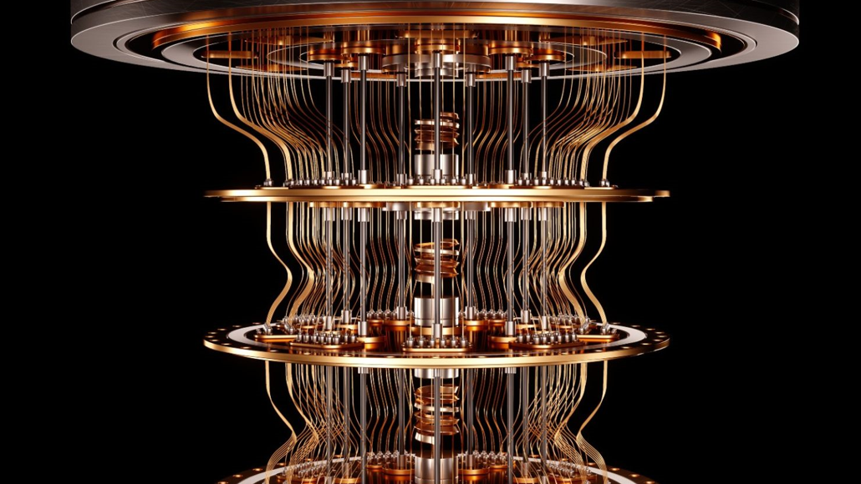
Quantum computing
Solving non-deterministic polynomial (NP) problems in polynomial time
CIS-655 Advanced Computer Architecture
Taught By Dr. Mohammed Abdallah
Anthony Redamonti

Slide 2
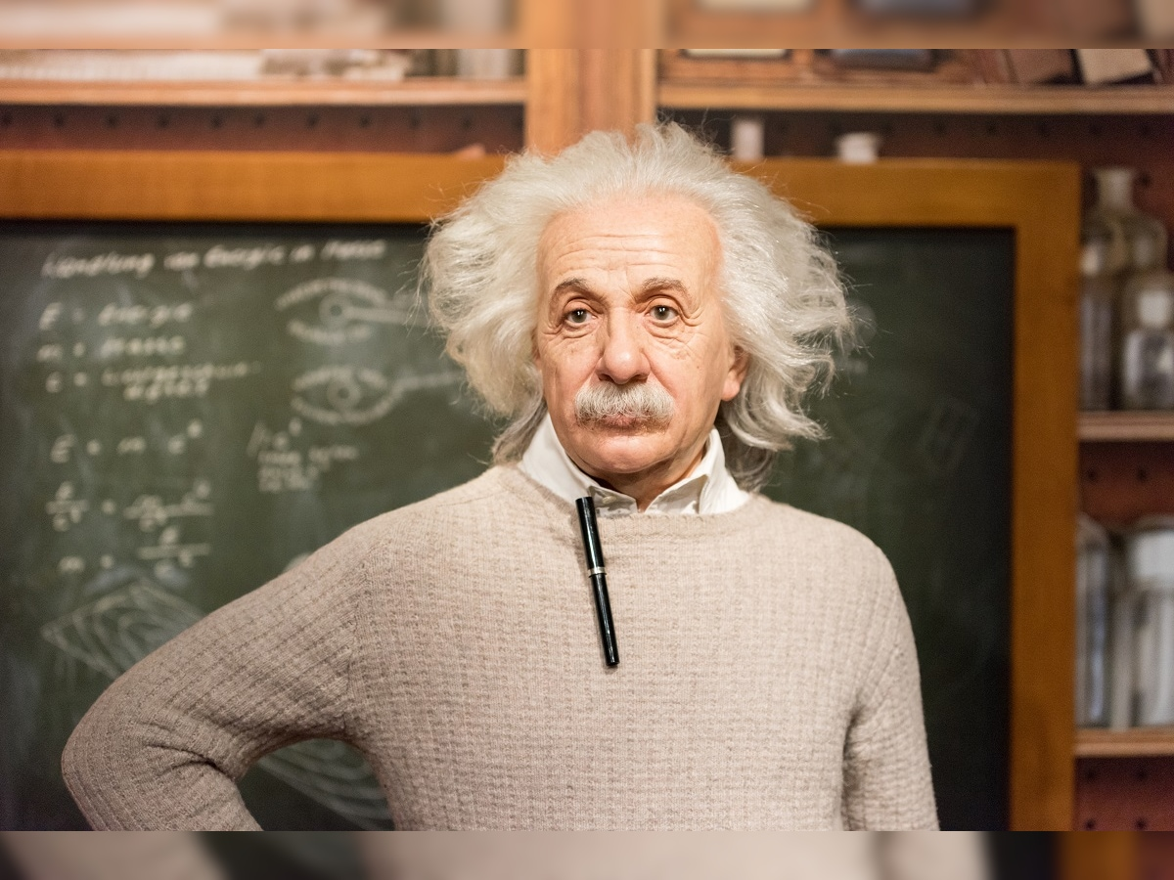
Quantum physics
“Spooky action at a distance.”

Slide 3
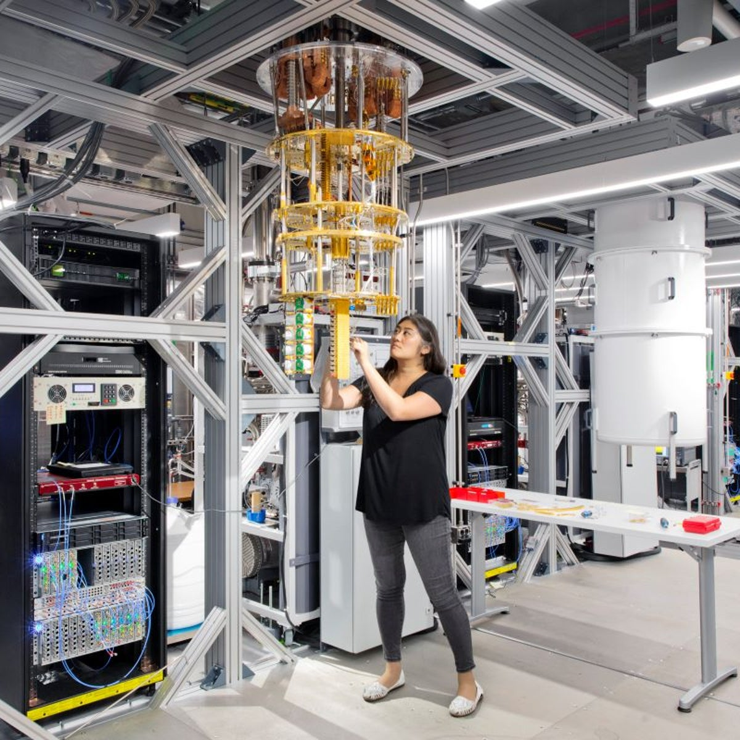
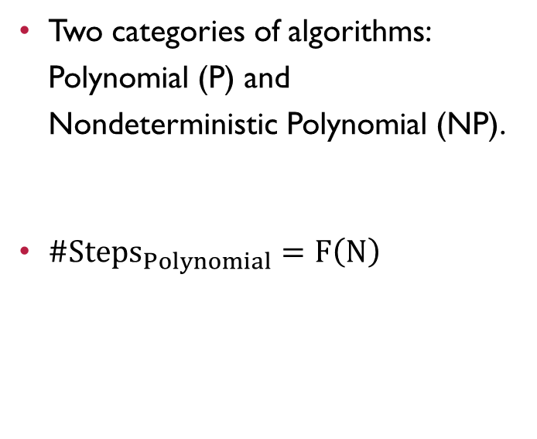
Background
Two categories of algorithms: Polynomial (P) and Nondeterministic Polynomial (NP).
$\#{Steps}_{Polynomial}=F\left(N\right)$

Slide 4
Example of Polynomial algorithm
Find the largest number in an array.
O(N)
Step 1
Step 2
Step 3
Step 4
Step 5
…
Step N
Done! Correct Answer

Slide 5
Example of NP algorithm
Find the shortest path between two nodes in a graph (data structure).
O(N^2)
Combin. 1 | Combin. 2 | Combin. 3 | Combin. 4 | … | Last Cmb
Step 1 | Step 1 | Step 1 | Step 1 | Step 1 | Step 1
Step 2 | Step 2 | Step 2 | Step 2 | Step 2 | Step 2
Step 3 | Step 3 | Step 3 | Step 3 | Step 3 | Step 3
Step 4 | Step 4 | Step 4 | Step 4 | Step 4 | Step 4
… | … | … | … | … | …
Step N | Step N | Step N | Step N | Step N | Step N
Not Done. | Not Done. | Not Done. | Not Done. | Not Done. | Done.

Slide 6
Motivation – NP Problems in everyday life
Balancing risk portfolios in investment banking
Molecular simulation to improve battery design
Finding a DNA sequence that best fits a collection of fragments (Human Genome Project)
Protein folding (finding a cure for cancer)
Drug simulation (big pharma)
Black Hole Simulation (Quantum Teleportation)

Slide 7
Problem statement
How to execute all possible inputs of an NP problem simultaneously?
Quantum Computing

Slide 8
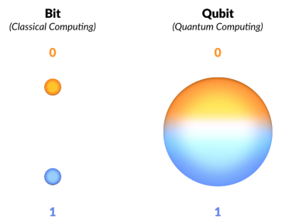
What is quantum computing?
A quantum computer is a computer that stores information in the form of qubits instead of binary.
Qubit: a subatomic particle, commonly represented by an electron.
Classical vs Quantum: transistor vs. electron

Slide 9

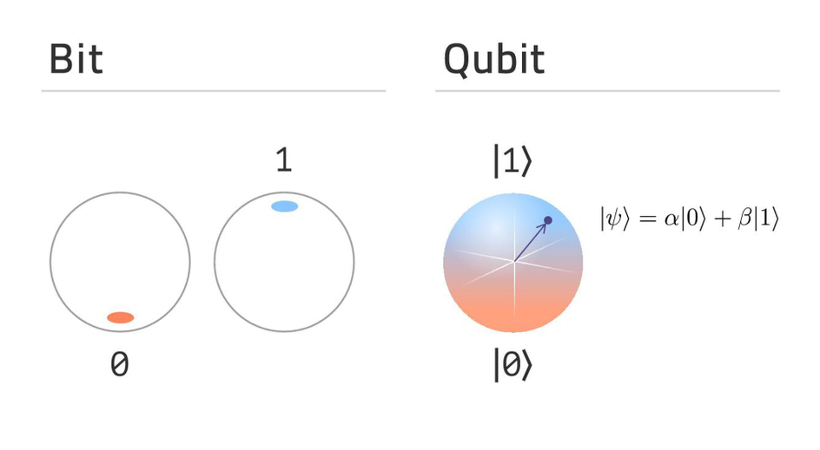
SUPERPOSITION
A qubit can represent all values between 0 and 1 due to its superpositional characteristic.
The state is no longer 0 or 1 and is represented with a state vector.

Slide 10

Quantum Hazard: Bump
Observation (measurement) changes state of Qubit.
How to observe state of Qubit???
By using entanglement.

Slide 11
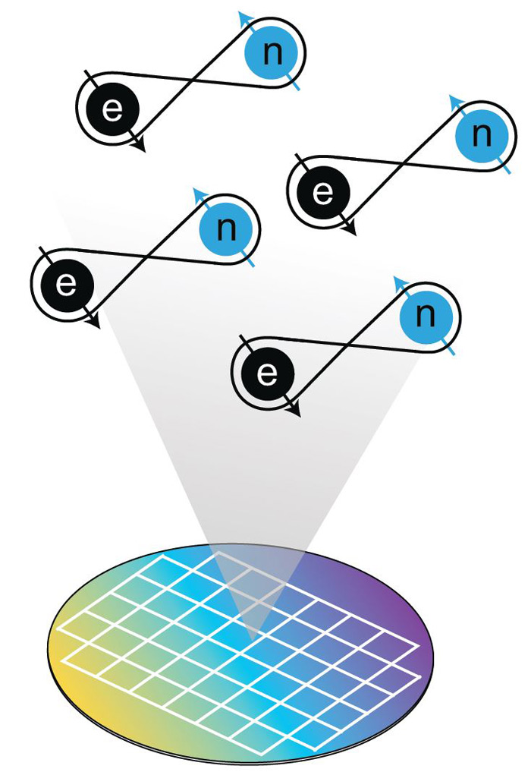
Entanglement
Outside force (voltage) acting on two or more subatomic particles creates an entangled state.
Entangled = Opposite Spin
Preserves the quantum state.
Quantum information is transmitted at speeds FASTER than the speed of LIGHT.
Notes:
If we have a pair of entangled subatomic particles, we can measure one of them and gather all quantum information about the other BEFORE we affect its quantum state.

Slide 12
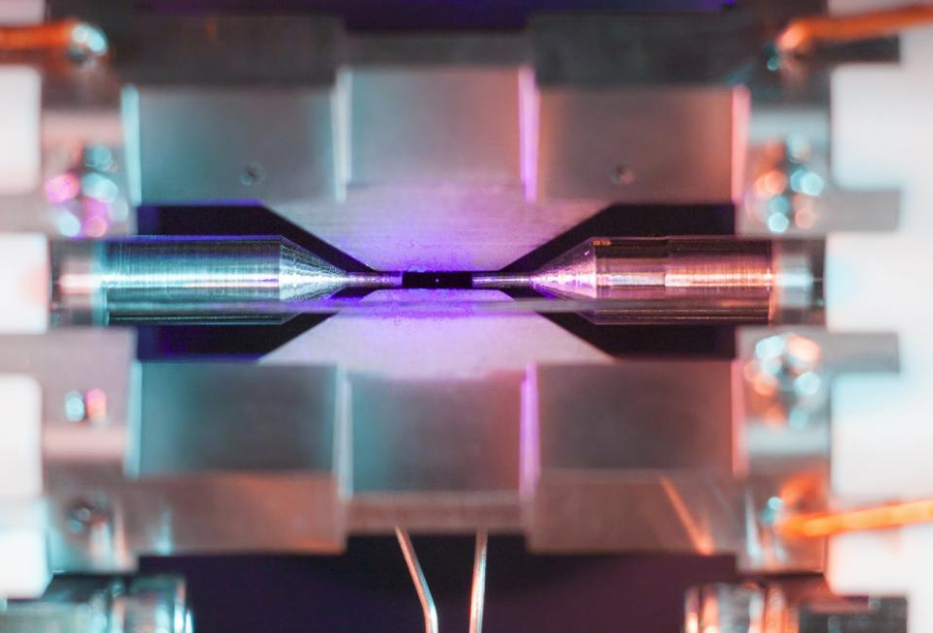
ION TRAPS: Qubit manipulation method
Chip housed in steel vacuum chamber at -450 degrees F.
Calcium and Strontium atoms flood chamber.
Lasers remove electrons from atoms, creating ions.
Ions are trapped by electrodes on chip’s surface.
Ions form Ca+/Sr+ crystal. Outmost electron = qubit.
Notes:
To trap these ions, the researchers will house a chip in a steel vacuum chamber. The chip is cooled to nearly 450 degrees below zero Fahrenheit. Calcium and Strontium atoms are then flooded into the chamber, and the lasers shoot the atom’s electrons, turning them into ions. The ions are trapped by electrodes which are attached to the chip’s surface. Other lasers are used to cool the ions keeping them in the trap. The ions come together to form a Ca+/Sr+ crystal. The quantum computer is concerned with reading the energy level of the outermost electron in this pairing, which will be used for computational analysis. The electron could be at a ground state |0> or excited state |1> or both states simultaneously.

Slide 13
CLOPS: Circuit layer operations per second
Measures the performance of a quantum system.
CLOPS: The number of superconducting circuits that can be addressed by the quantum processing unit (QPU) per unit time.
IBM has defined the three biggest factors in quantum computing as speed (CLOPS), scalability, and quality (accuracy).
IBM to release world’s first 1,000 qubit computer by 2023. (There are less than 2^300 atoms in the universe)

Slide 14
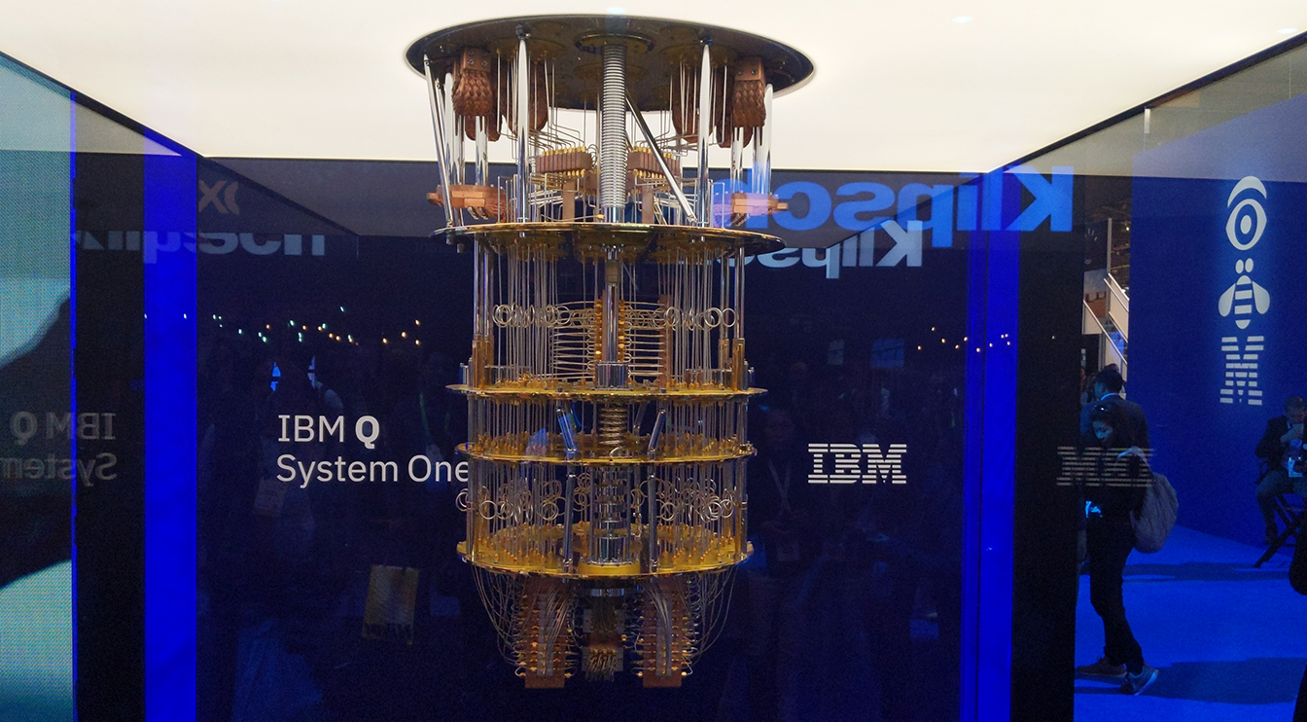
Notes:
IBM’s earlier “Q System One,” the world’s first circuit-based commercial quantum computer.

Slide 15
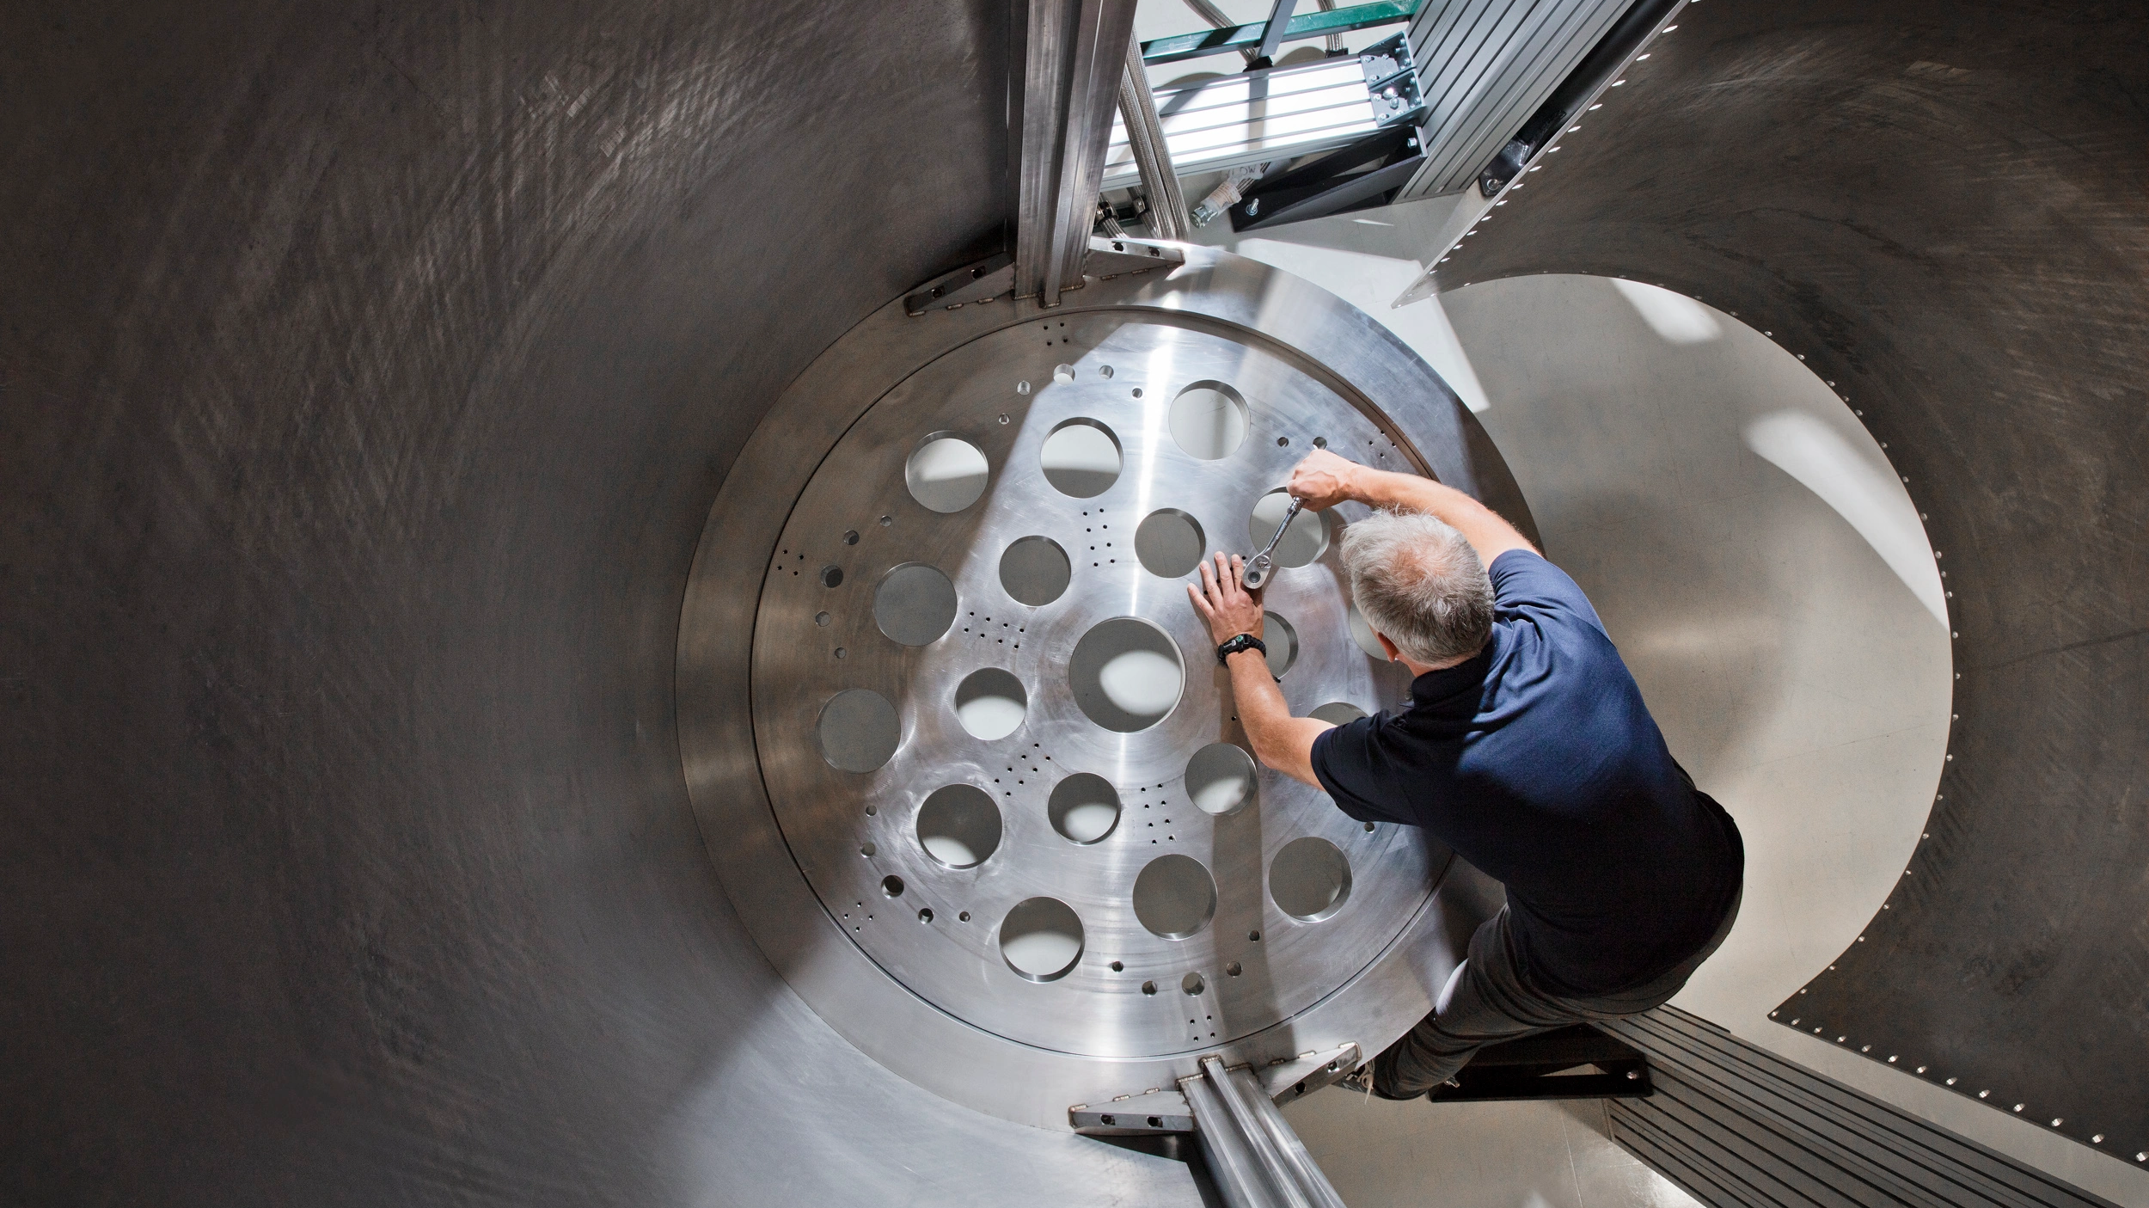
Notes:
An IBM engineer working on the refrigerator casing inside of which the company plans to install a 1 million-qubit quantum computer by 2030.

